Slide 1
Signal processing

Slide 2
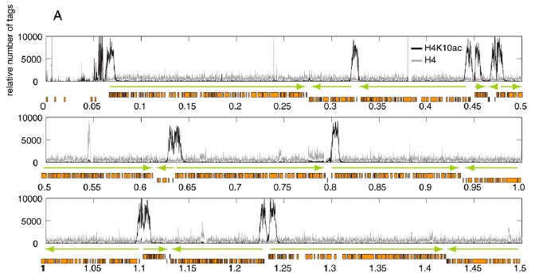
Example data – ChIP-Seq
T.N. Siegel, D.R. Hekstra, L.E. Kemp, L.M. Figueiredo, J.E. Lowell, D. Fenyö, X. Wang, S. Dewell, G.A. Cross, "Four histone variants mark the boundaries of polycistronic transcription units in Trypanosoma brucei", Genes Dev. 23 (2009) 1063-1076.

Slide 3
Example data – ChIP-Seq
Sun X et al., Transcription factor profiling reveals molecular choreography and key regulators of human retrotransposon expression, PNAS 2018.

Slide 4
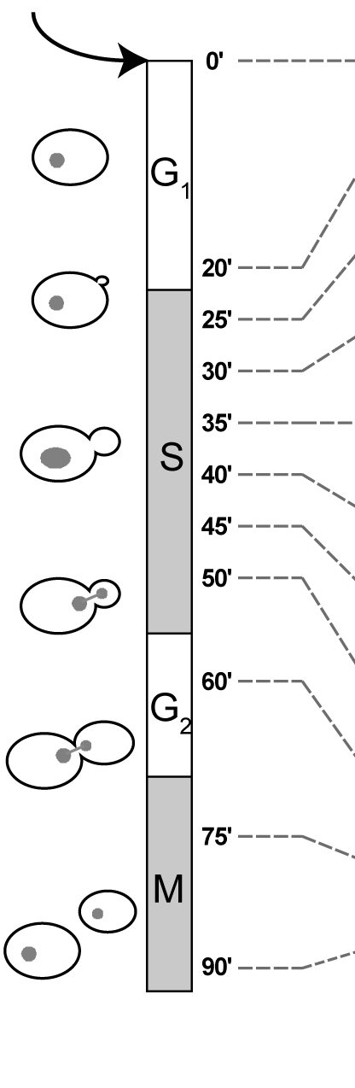
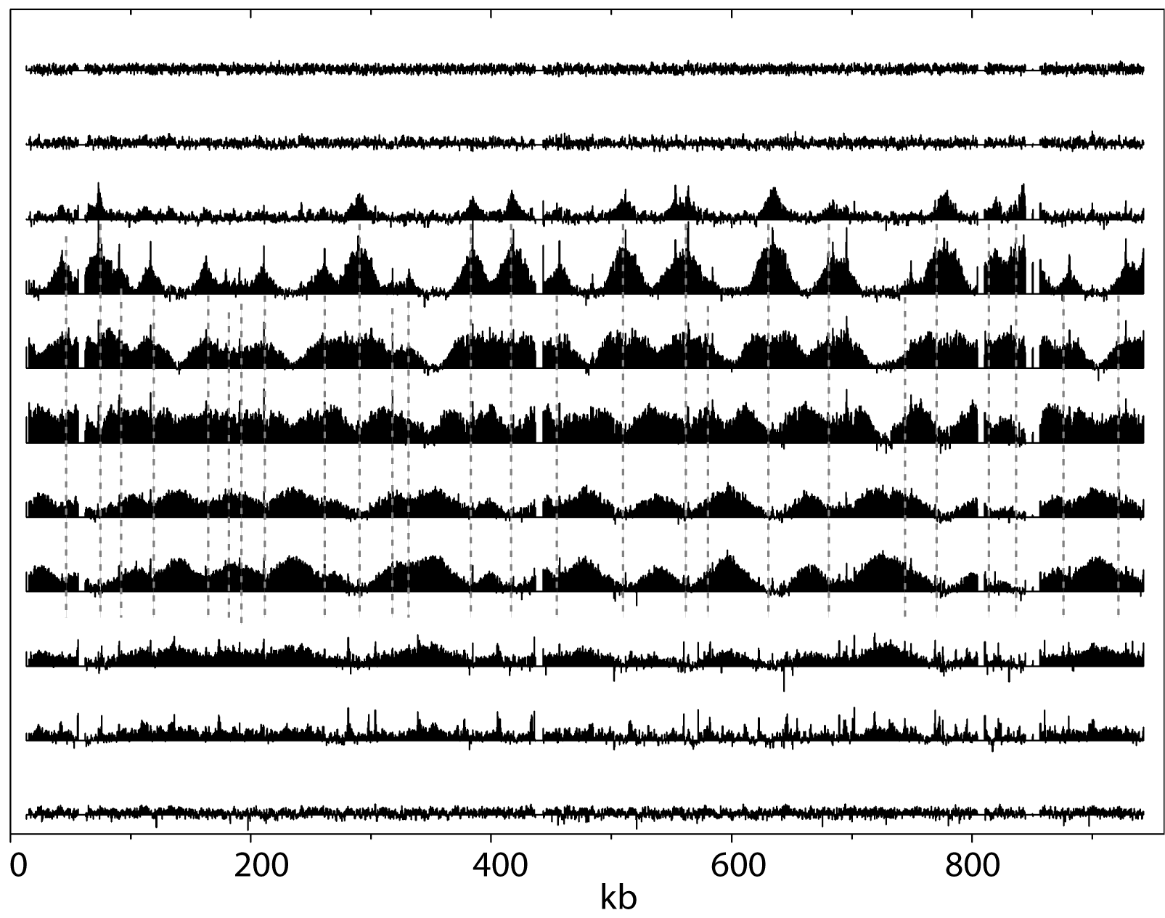
Example Data: Time-Resolved ChIP-chip
α-factor release
Chromosome 16
M.D. Sekedat, D. Fenyö, R.S. Rogers, A.J. Tackett, J.D. Aitchison, B.T. Chait, "GINS motion reveals replication fork progression is remarkably uniform throughout the yeast genome", Mol Syst Biol. 6 (2010) 353.

Slide 5
Example data – MALDI-TOF
Peptide intensity vs m/z

Slide 6
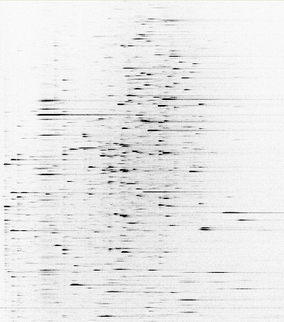
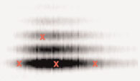
Example data – ESI-LC-MS/MS
Peptide intensity vs m/z vs time
m/z
762
MS/MS
100
875
[M+2H]²⁺
% Relative Abundance
292
633
260
405
534
1022
389
504
907
1020
663
778
1080
0
250
500
750
1000
m/z
Fragment intensity vs m/z
Time

Slide 7
Example Data: Super-Resolution Microscopy
Dylan Reid and Eli Rothenberg

Slide 8
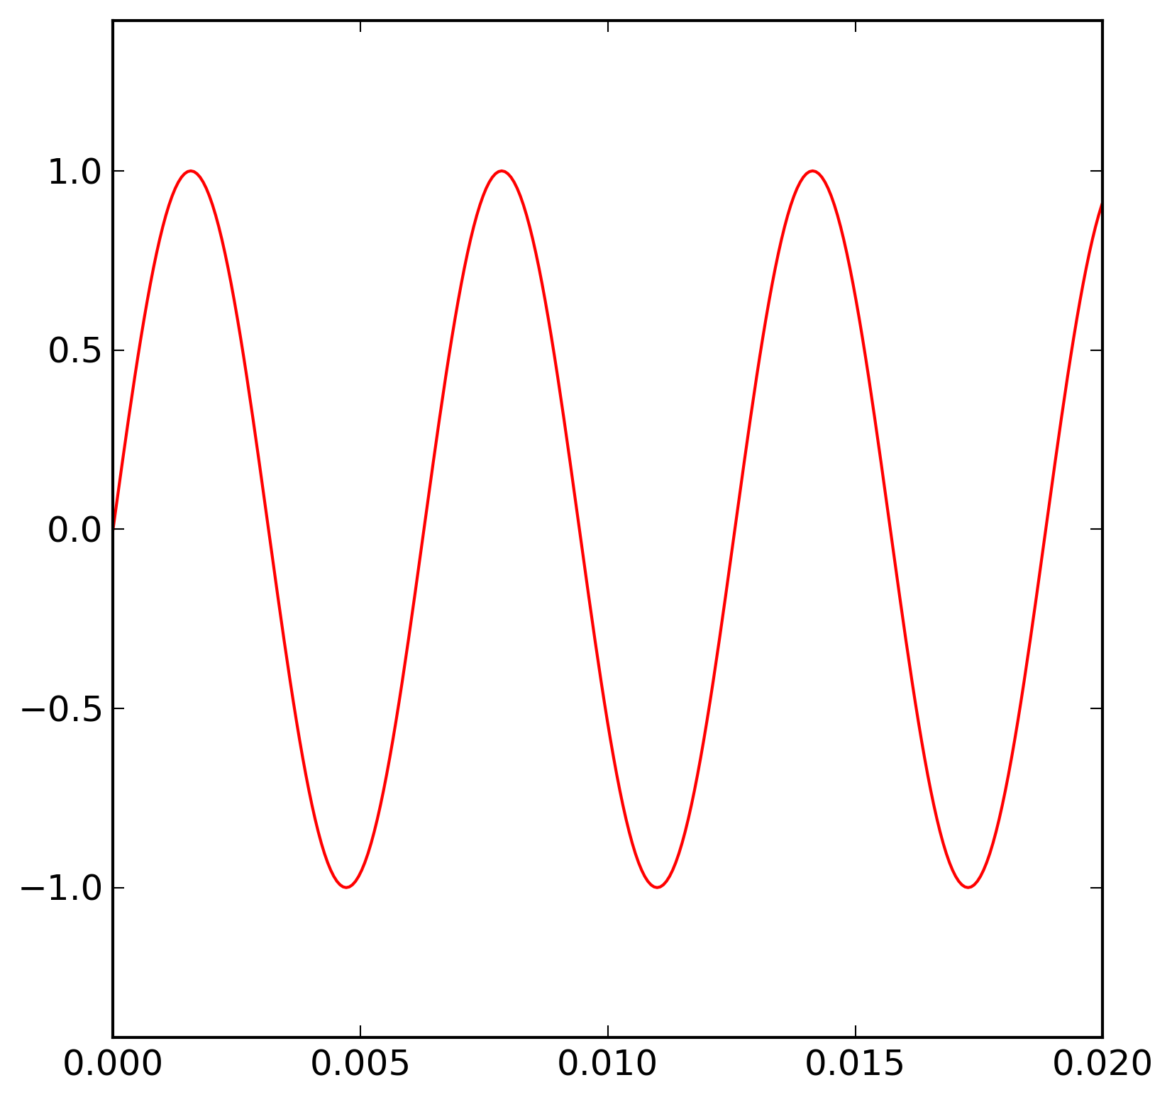
Sinus
amplitude
c
a
α
b
Wave length

Slide 9
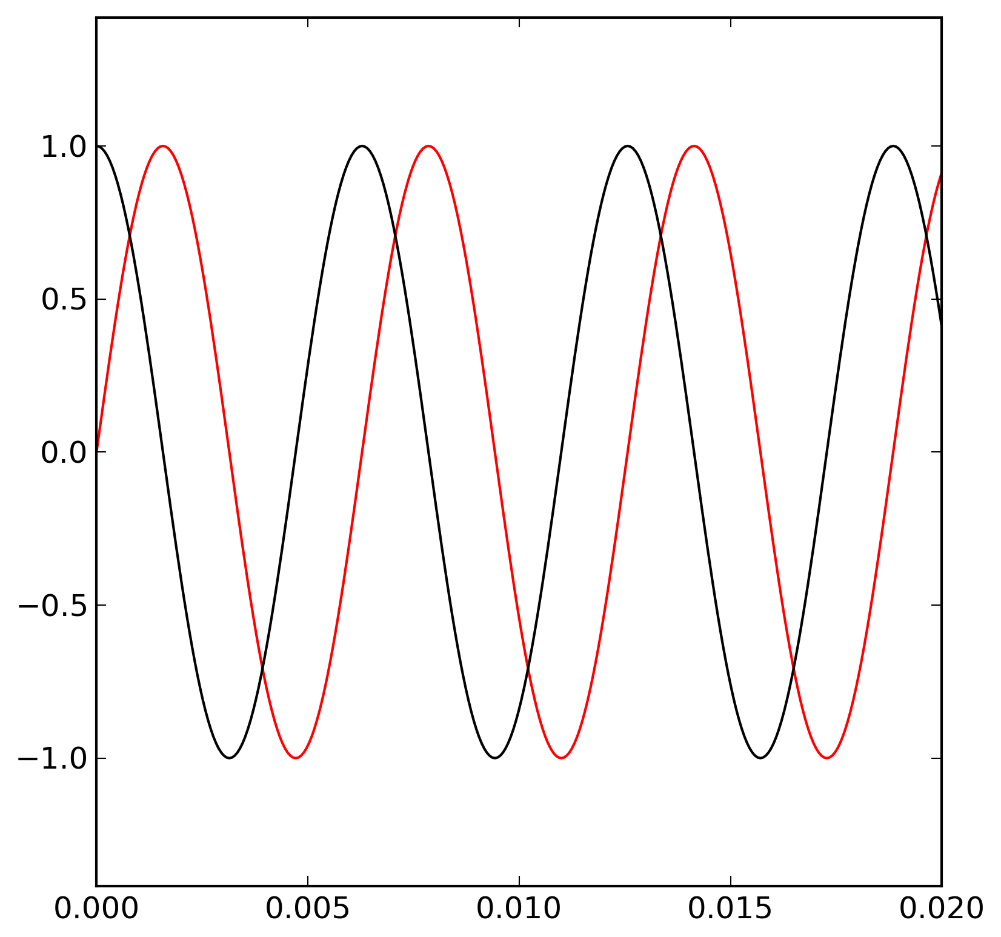
Sinus and Cosinus
c
a
α
b

Slide 10
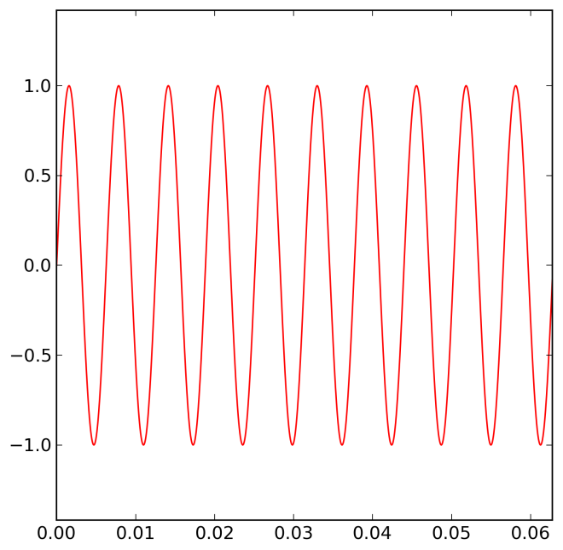
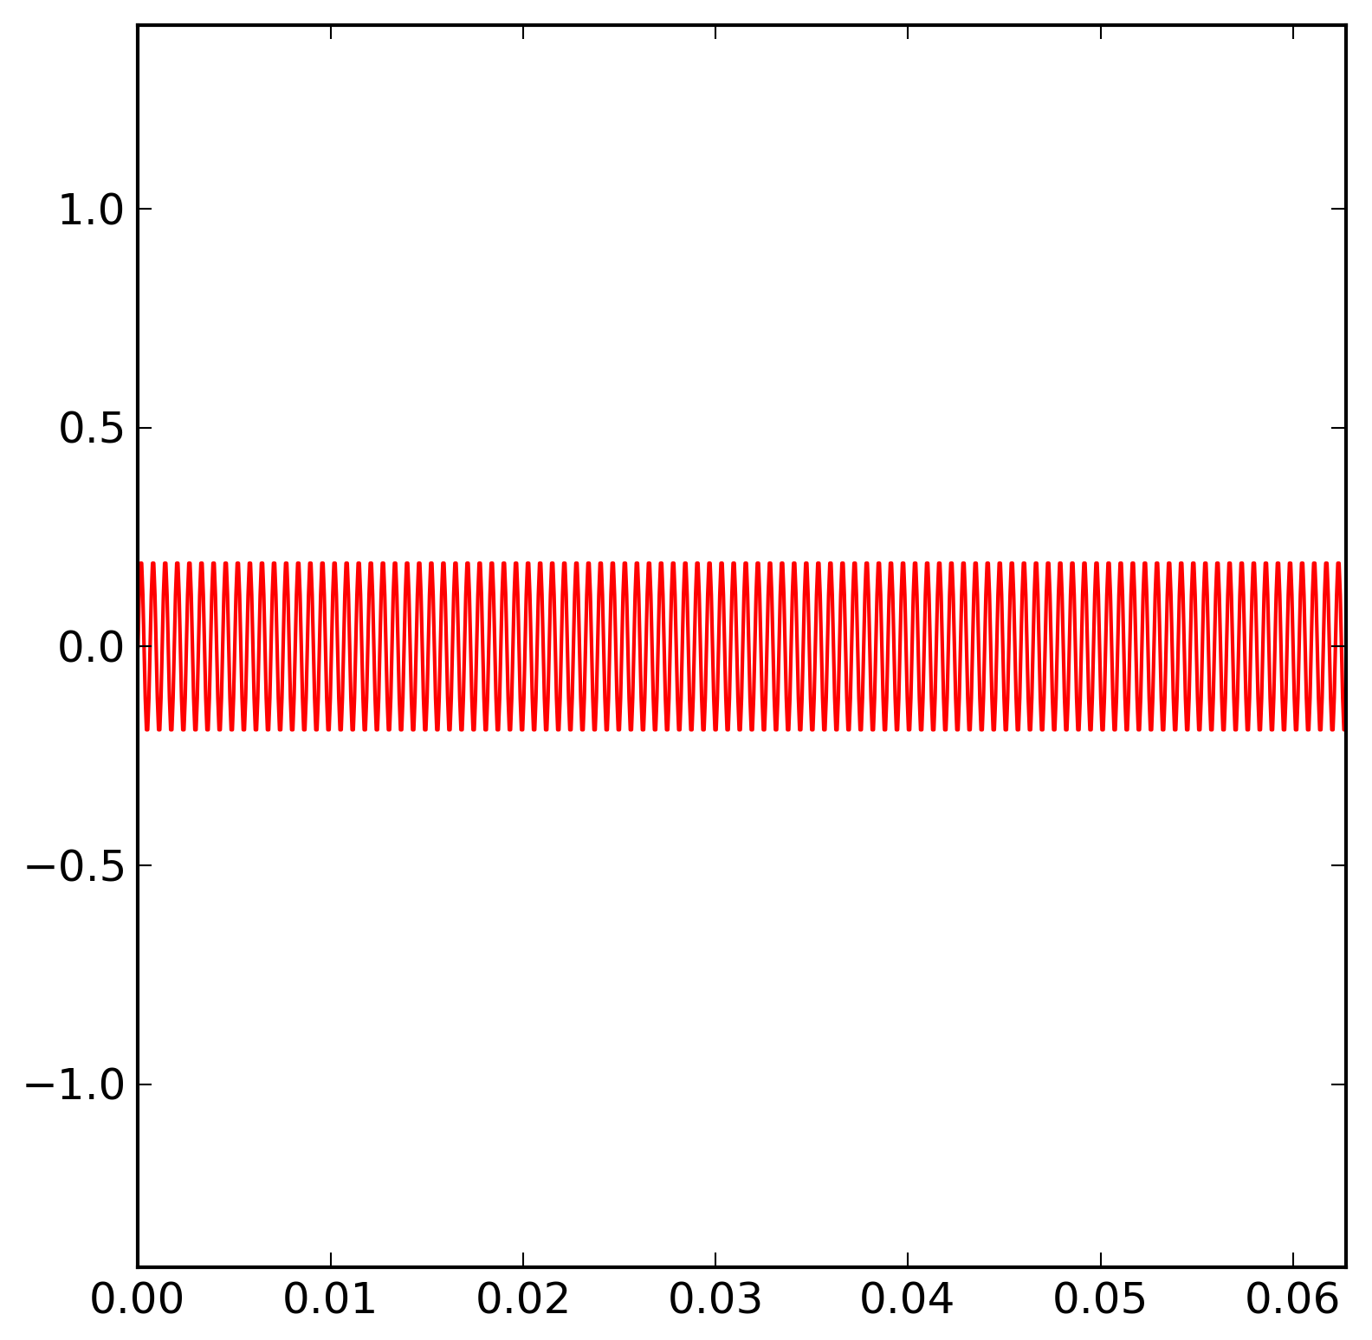
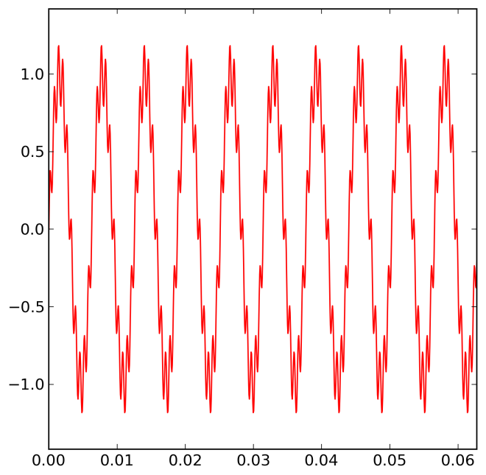
Two Frequencies

Slide 11
Fourier Transform

Slide 12
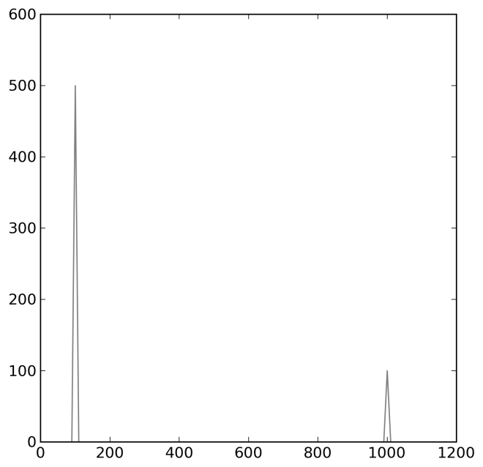
Fourier Transform
Frequency
from numpy import *
x=2.0*pi*arange(1000.0)/100000.0
sin1 = sin(1000.0*x)
sin2 = 0.2*sin(10000.0*x)
sin12=sin1+sin2
fft12=fft.rfft(sin12)

Slide 13
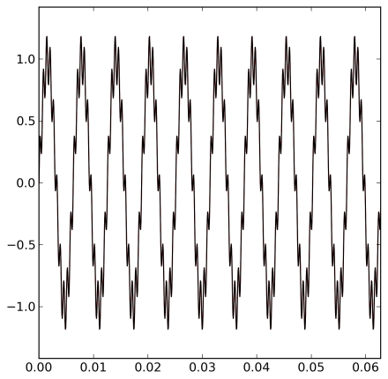
Inverse Fourier Transform
Frequency

Slide 14
Inverse Fourier Transform
Frequency
from numpy import *
x=2.0*pi*arange(1000.0)/100000.0
sin1 = sin(1000.0*x)
sin2 = 0.2*sin(10000.0*x)
sin12=sin1+sin2
fft12=fft.rfft(sin12)
sin12_=
fft.irfft(fft12,len(sin12))

Slide 15
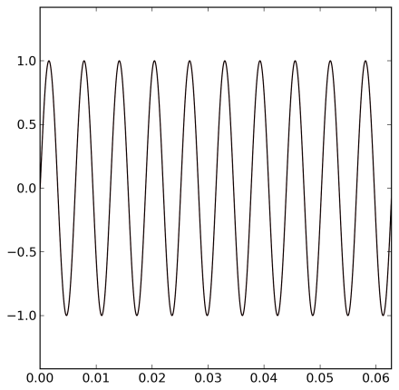
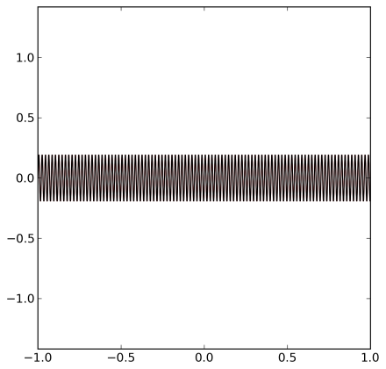
Inverse Fourier Transform
Frequency

Slide 16
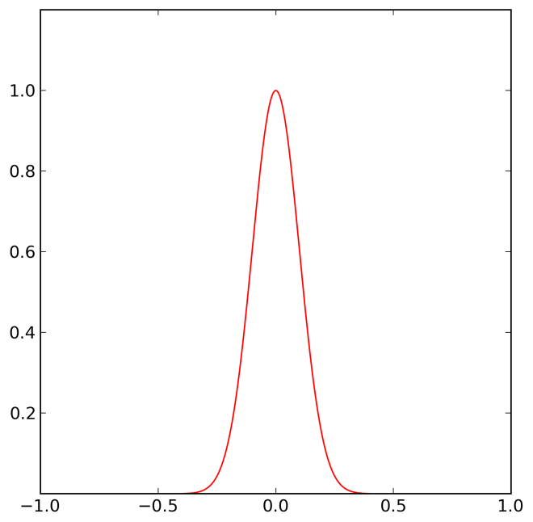
A Peak
maximum
mean
variance
skewness
kurtosis
Intensity
full width
at half
maximum
(FWHM)
height
centroid
area

Slide 17
Mean and variance
A peak is defined by and
Mean
Variance

Slide 18
Skewness and kurtosis
Skewness
Kurtosis

Slide 19
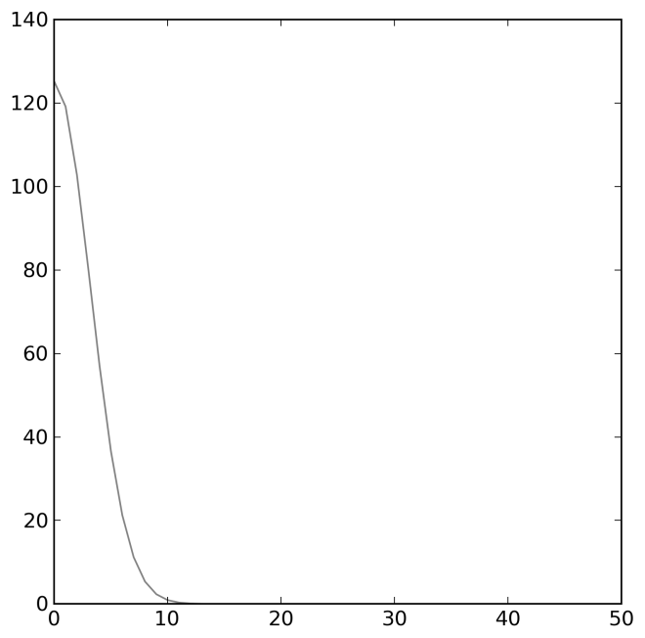
A Gaussian Peak
Frequency
def gaussian(x,x0,s):
return exp(-(x-x0)**2/(2*s**2))
x = linspace(-1,1,1000)
y=gaussian(x,0,0.1)
ffty=fft.rfft(y)

Slide 20
A Gaussian Peak
Frequency
Skewness = 0
Kurtosis = 0

Slide 21
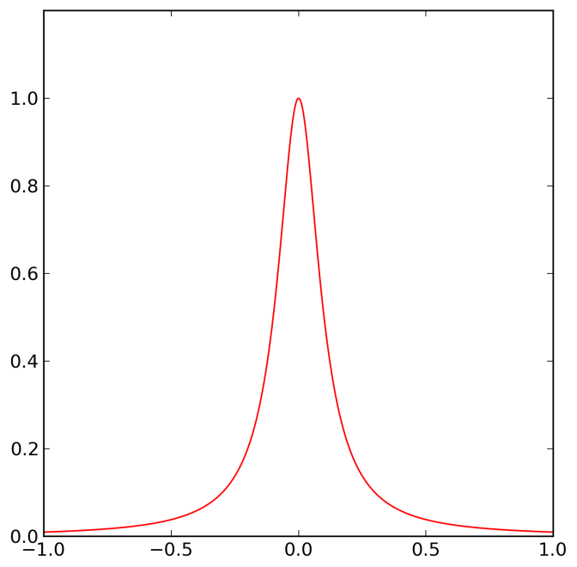
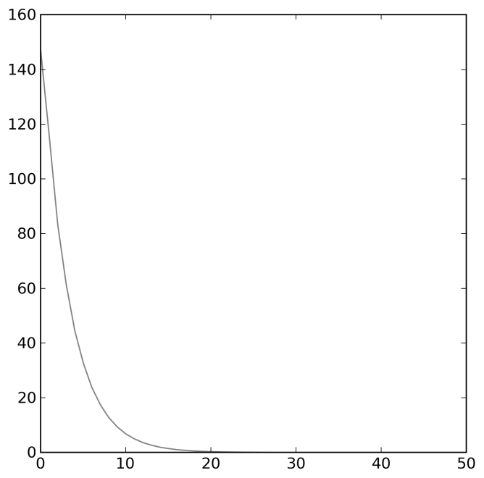
Peak with a longer tail
Frequency

Slide 22
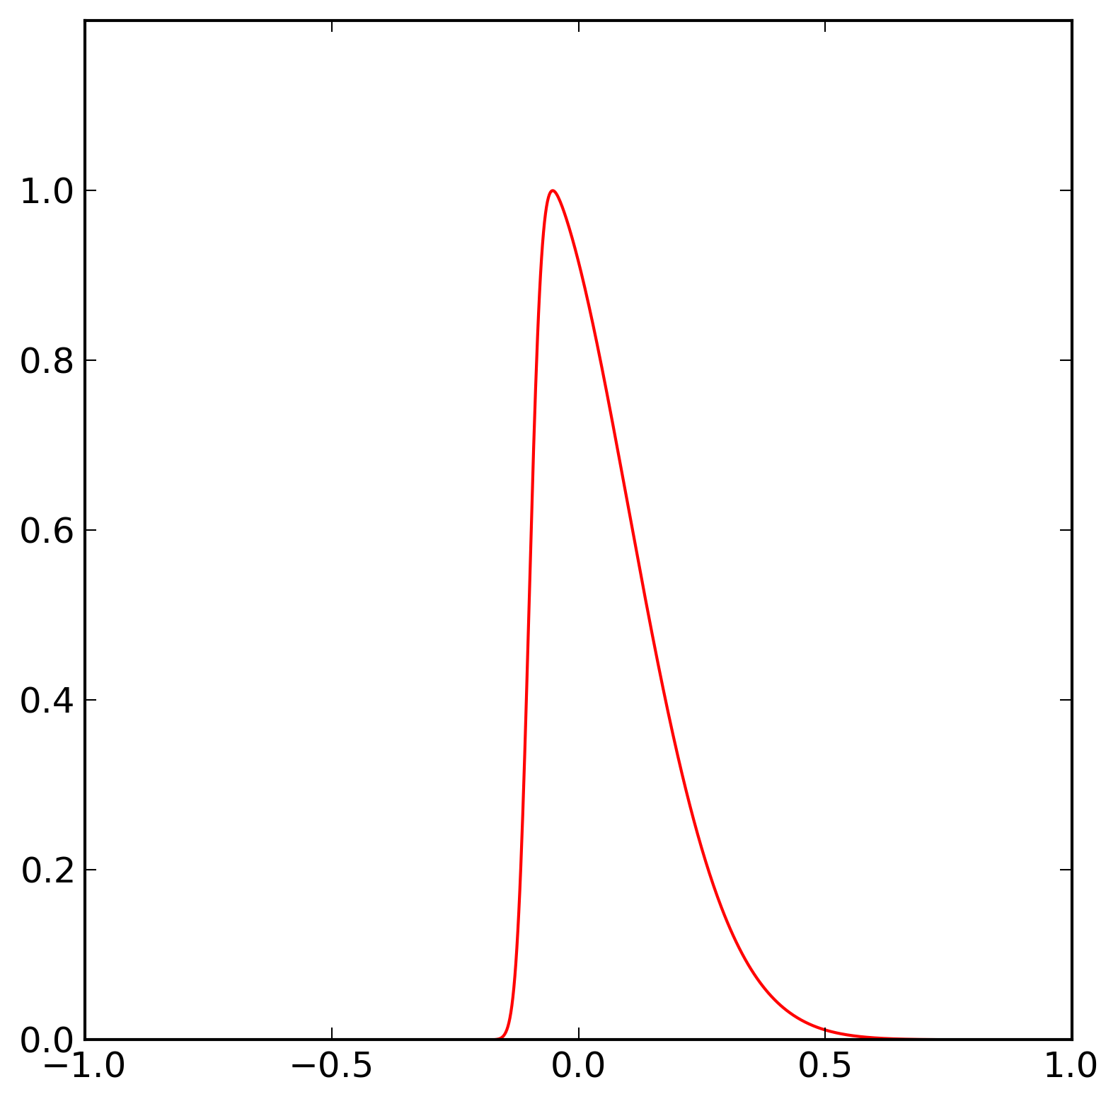
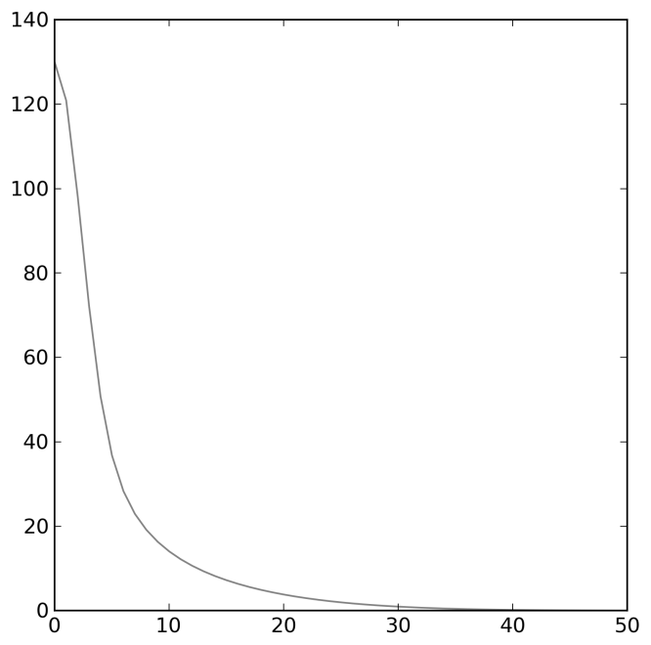
A skewed peak
Frequency
def pdf(x):
return 1/sqrt(2*pi) * exp(-x**2/2)
def cdf(x):
return (1 + erf(x/sqrt(2))) / 2
def skew(x,e=0,w=1,a=0):
t = (x-e) / w
return 2 / w * pdf(t) * cdf(a*t)

Slide 23
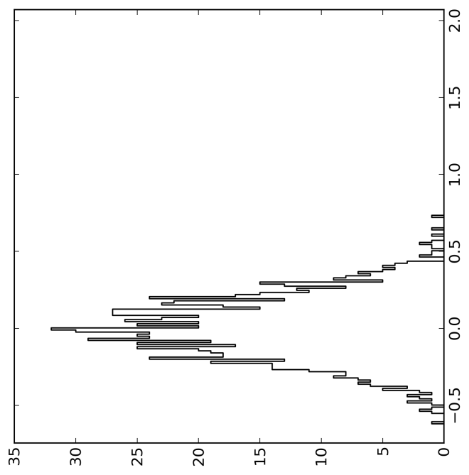
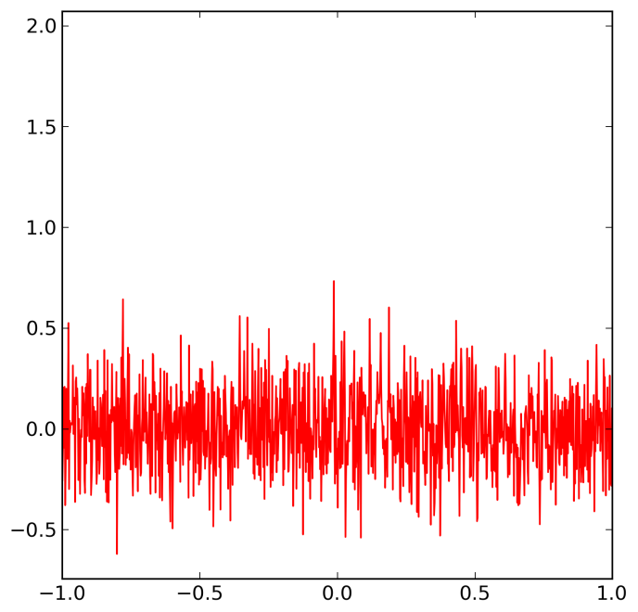
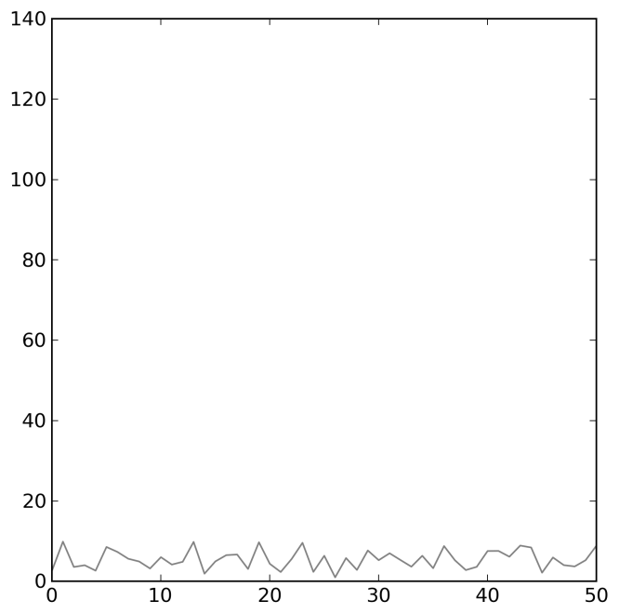
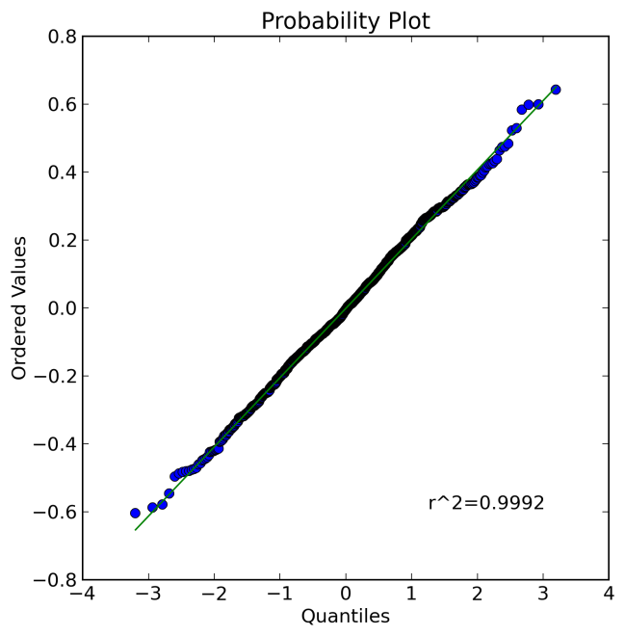
Normal noise
Frequency
x = linspace(-1,1,1000)
y=0.2*random.normal(size=len(x))
If the noise is not normally
distributed, try to find a
transform that makes it normal

Slide 24
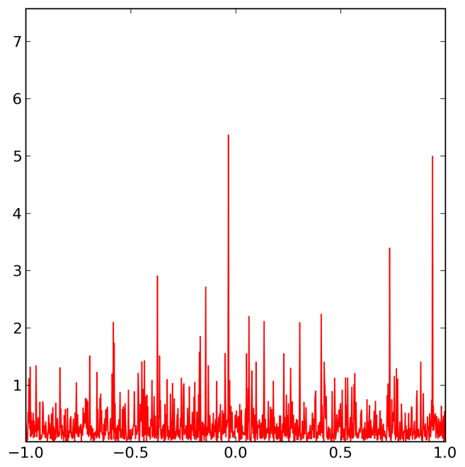
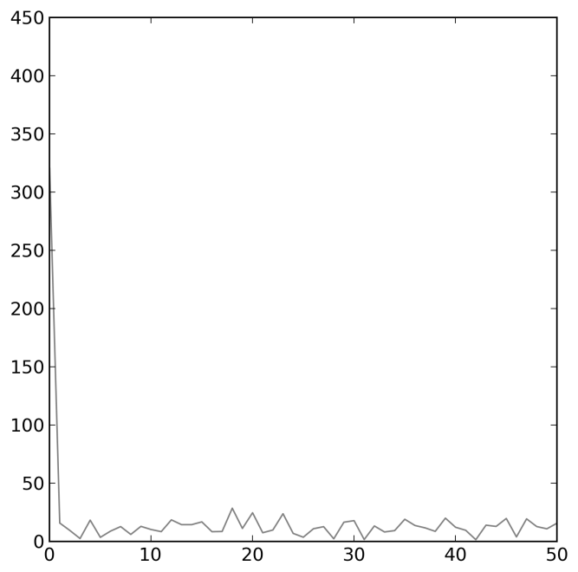
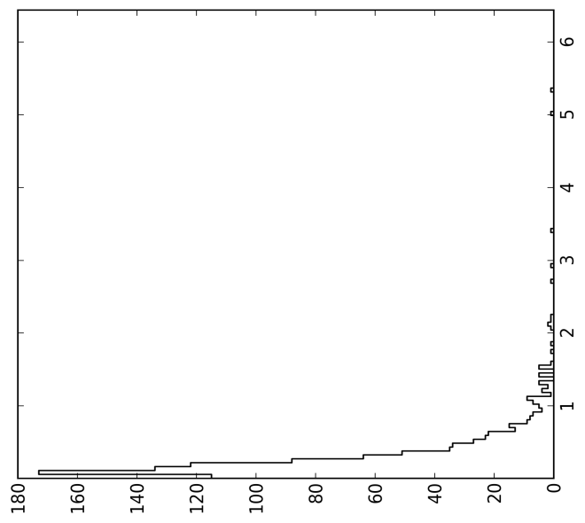
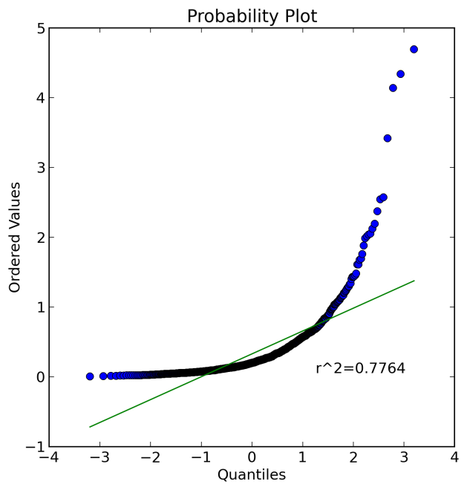
Lognormal noise
Frequency
x = linspace(-1,1,1000)
y=0.2*random.lognormal(size=len(x))

Slide 25
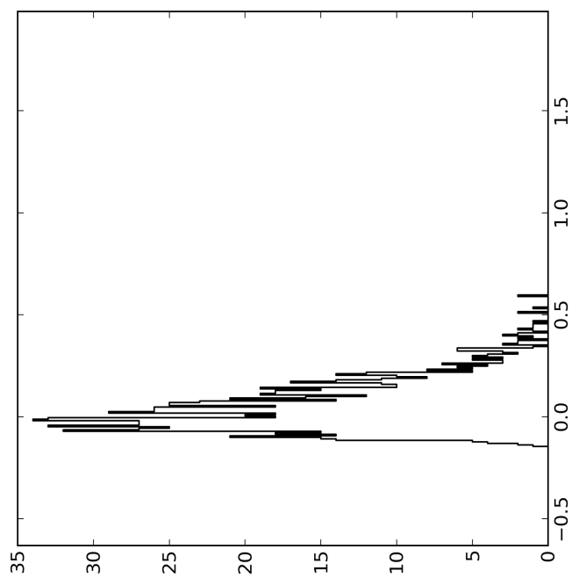
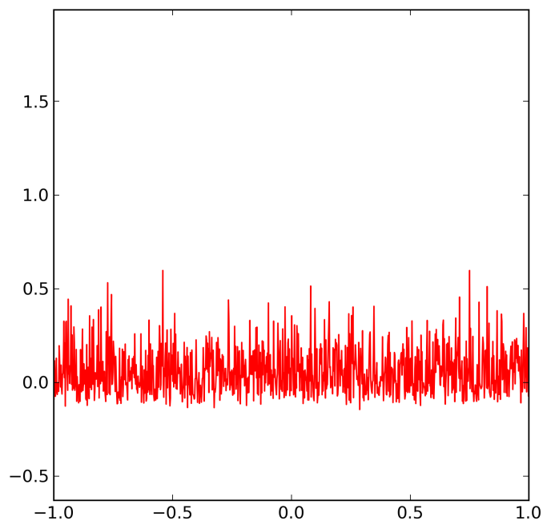
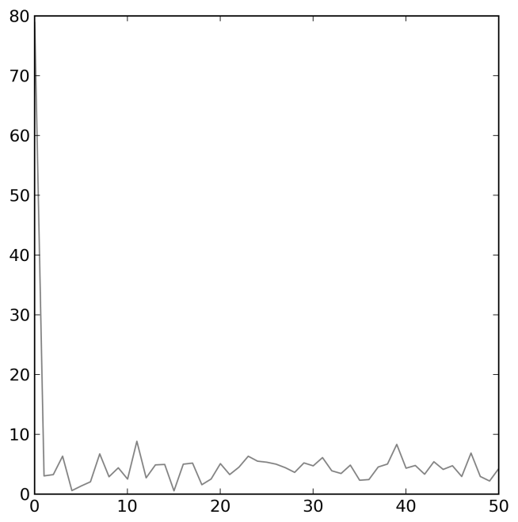
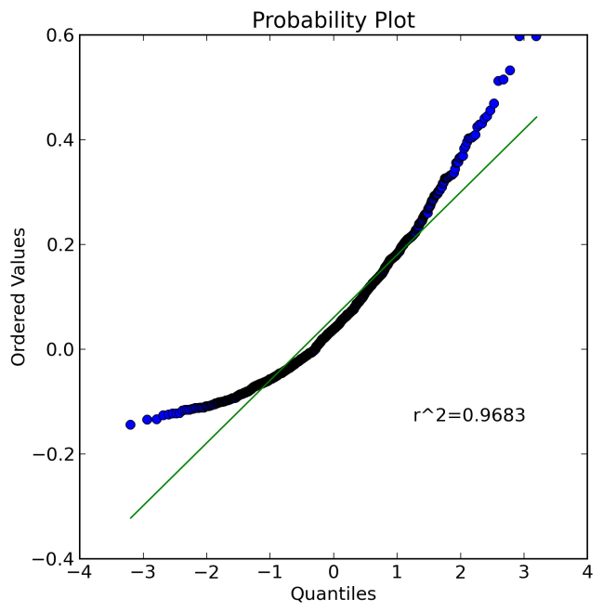
Skewed noise
Frequency
x=random.uniform(-1.0,1.0,size=10*len(x))
y=random.uniform(0.0,1.0,size=10*len(x))
yskew=skew(x,-0.1,0.2,10)/max(yskew)
yn_skew=x_test[y<yskew][:len(x)]

Slide 26
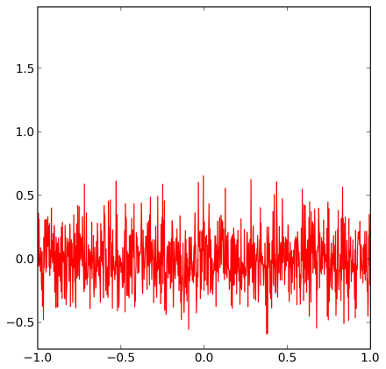

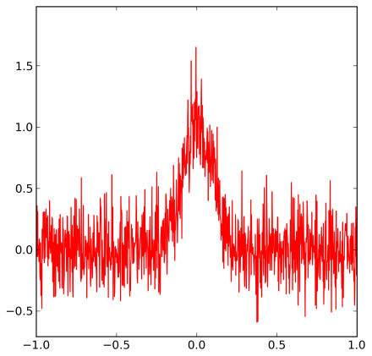
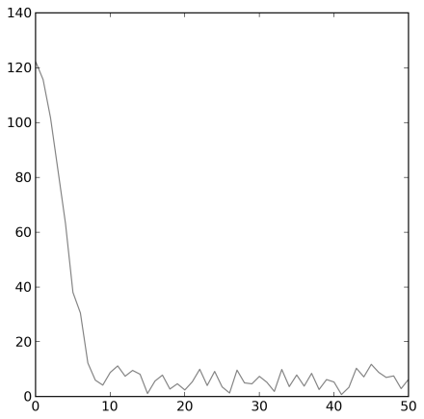
Gaussian peak with normal noise
Frequency
Frequency
Frequency

Slide 27
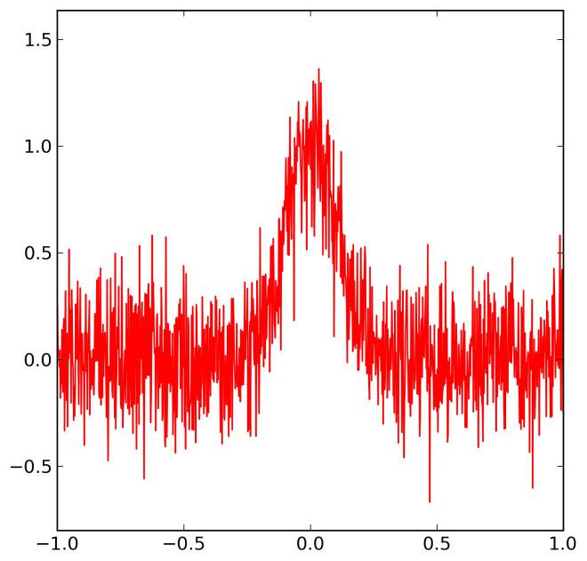
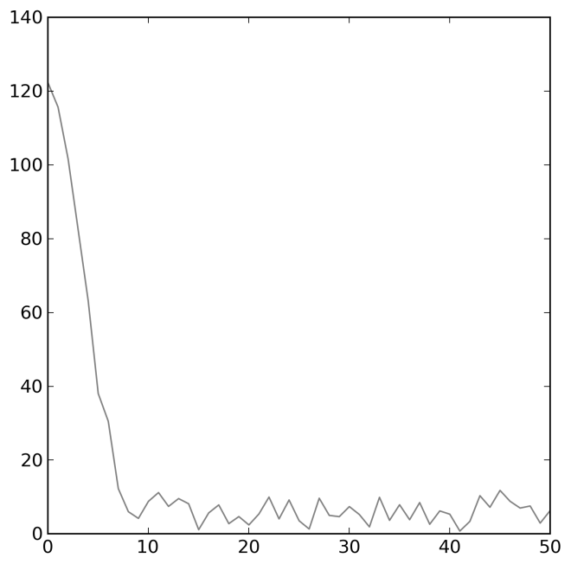
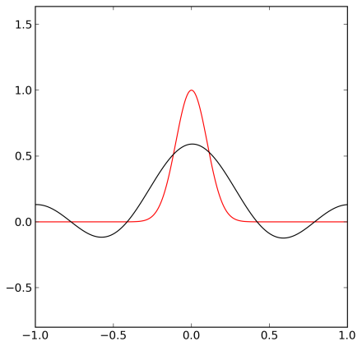
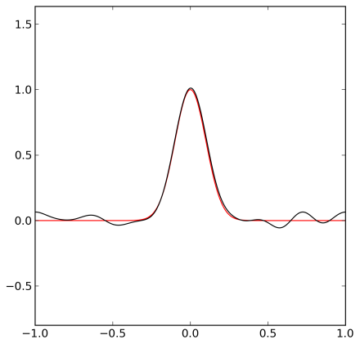
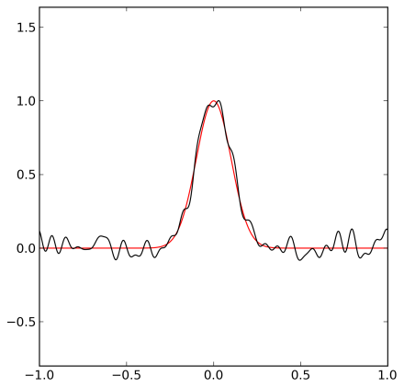
Removing High Frequences
Frequency

Slide 28
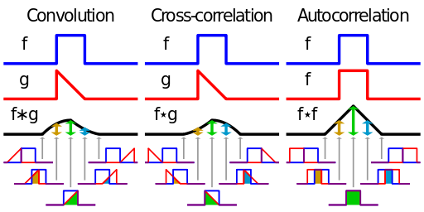
Convolution
Describes the response of a linear and time-invariant system to an input signal
The inverse Fourier transform of the pointwise product in frequency space
http://en.wikipedia.org/wiki/Convolution

Slide 29
Smoothing by convolution

Slide 30
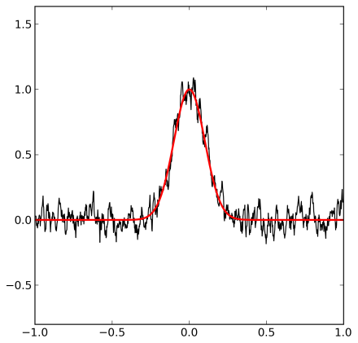
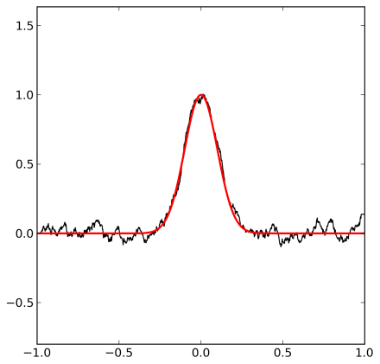
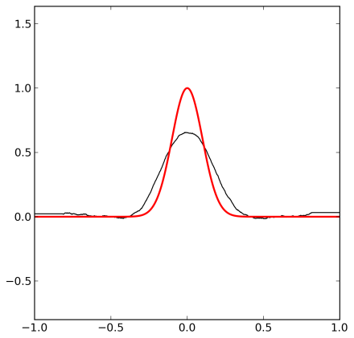
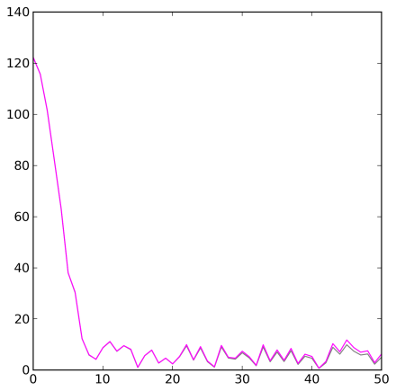
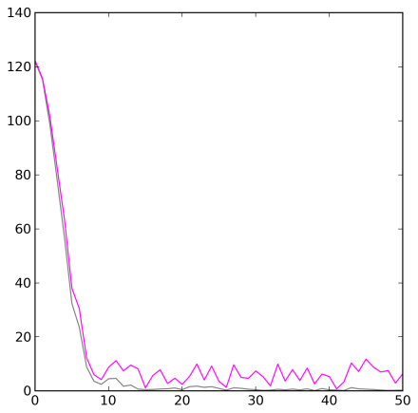
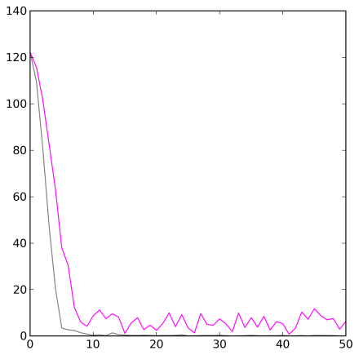
Smoothing
Intensity
w=ones(2*width+1,'d')
convolve(w/w.sum(),y,'valid‘)
Frequency
Frequency
Frequency

Slide 31
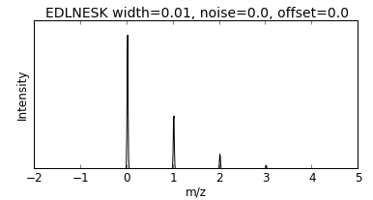
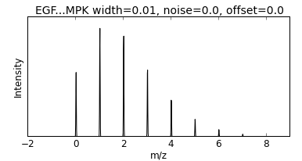
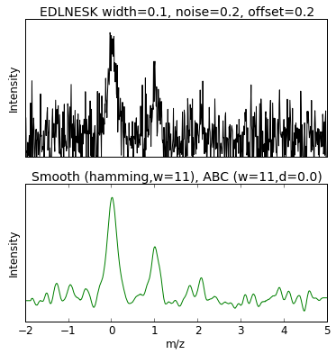

Smoothing

Slide 32


Smoothing

Slide 33

Adaptive Background Correction (unsharp masking)
wi = linspace(1,window_len,window_len)
w = 1 / ( 2*r_[wi[::-1],0,wi] + 1 )
x_ = x - d*convolve(w/w.sum(),x,'valid')
Original
Unsharp masking

Slide 34


Adaptive Background Correction

Slide 35


Smoothing and Adaptive Background Correction

Slide 36









Savitsky-Golay smoothing
Polynomial order = 3
Polynomial order = 5
Polynomial order = 7
Bin size = 25
Bin size = 75
Bin size = 150

Slide 37




Background
Frequency
Frequency

Slide 38






Background Subtraction Using Smoothing
Bin size = 100
Bin size = 200
Bin size = 300
Smooting
Smooting
Smooting
Background subtraction
Background subtraction
Background subtraction

Slide 39
Root Mean Square Deviation (RMSD)
The Root Mean Square Deviation (RMSD) is often
constant for the noise and larger for the peak if
the window size is approximately the size of the peak.

Slide 40






Background Subtraction using RMSD
Bin size = 100
Bin size = 200
Bin size = 300
RMSD
RMSD
RMSD
Intensity
Intensity
Intensity

Slide 41
Convolution, Cross-correlation, and Autocorrelation
Convolution describes the response of a linear and
time-invariant system to an input signal.
The inverse Fourier transform of the pointwise product in frequency space.
Cross-correlation is a measure of similarity of two signals.
It can be used for finding a shift between two signals.
Auto-correlation is the cross-correlation of a signal with itself.
It can be used for finding periodic signals obscured by noise.
http://en.wikipedia.org/wiki/Convolution

Slide 42
Cross-correlation and autocorrelation
http://en.wikipedia.org/wiki/Convolution

Slide 43


Autocorrelation
Signal
Autocorrelation
Same signal

Slide 44



Cross-correlation
Signal
Cross-correlation
Shifted signal

Slide 45



Cross-correlation
Signal
Cross-correlation
Half of the peaks shifted

Slide 46
How similar are two signals?
Dot product
Identical vectors:
Perpendicular vectors:
The dot product is the came as the cross-correation at zero:

Slide 47















What are the characteristics of the dot product?
10 3 1 0.3 0.1 S/N
10
100
1000
Dimensions
Signal+Noise
Noise

Slide 48




Autocorrelation
Signal
Sum of signal and shifted signal
Autocorrelation
Shifted signal

Slide 49






Coincidence – enhances the signal
The signal to noise can be dramatically increased by measuring several independent signals of the same phenomenon and combining these signals.
Ideal signal
Four measurements
Product of the four measurements

Slide 50



Coincidence – supresses and transforms the noise
Original noise
Noise in product

Slide 51





Coincidence – supresses interference
Four measurements with interference
Ideal signal
Product of the four measurements

Slide 52
Peak Finding
The derivative of a function is zero at its
minima and maxima.
The second derivative is negative at maxima and
positive at minima.

Slide 53

Detection of steps
Intensity
Motivation: To demonstrate a general strategy for
separating signal from noise:
Characterize the signal and the noise
Make a model of the data
Select detection method
Select parameters using simulations

Slide 54



Detection of steps: Characterization of noise
Remove signal by
subtracting a
moving average

Slide 55



Detection of steps: Model of data
S/N=0.75
S/N=1
S/N=2
points=1000
x = linspace(-1,1,points)
y=noise*random.normal(size=len(x))
y[points/2:]+=signal

Slide 56



Detection of steps: Detection method
S/N=0.75
S/N=1
S/N=2
Steps can be converted into peaks by calculating
the difference between the moving average in
two windows

Slide 57









Detection of steps: Detection method
S/N=0.75
S/N=1
S/N=2
Bin size = 10
Average Intensity
Average Intensity
Average Intensity
Bin size = 30
Average Intensity
Average Intensity
Average Intensity
Bin size = 100
Average Intensity
Average Intensity
Average Intensity

Slide 58









Detection of steps: Simulations - peak location
S/N=0.05
S/N=0.25
S/N=1
Bin size = 10
Bin size = 30
Bin size = 100

Slide 59









Detection of steps: Simulations – correct peak
S/N=0.05
S/N=0.25
S/N=1
Bin size = 10
Frequency
Frequency
Frequency
Score
Score
Score
Bin size = 30
Frequency
Frequency
Frequency
Score
Score
Score
Bin size = 100
Frequency
Frequency
Frequency
Score
Score
Score

Slide 60









Detection of steps: Simulations - FDR and FNR
S/N=0.05
S/N=0.25
S/N=1
Bin size = 10
False Rate
False Rate
False Rate
Threshold
Threshold
Threshold
False
Negative
Rate
Bin size = 30
False Rate
False Rate
False Rate
False
Discovery
Rate
Threshold
Threshold
Threshold
Bin size = 100
False Rate
False Rate
False Rate
Threshold
Threshold
Threshold

Slide 61




Signal Processing Lab:
Transcription factor binding to LINE-1
MYC
CTCF
Sun X et al., Transcription factor profiling reveals molecular choreography and key regulators of human retrotransposon expression, PNAS 2018.

Slide 62



Signal Processing Lab: Peak Finding Examples
Example 1
Example 2
Example 3

